Slide 1


KICKAAS
KICK AS A SERVICE
Johannes Bekele, Saniya Bhambhvani, Javier Esteban de Celis, Vamsi Garghi, Yuanfei He, and Shreya Rana

Slide 2

TABLE OF CONTENTS
Our Team
Project Scope
Functional Requirements
Tech Stack

Slide 3

OUR TEAM
OUR TEAM
OUR TEAM
OUR TEAM
OUR TEAM

Slide 4




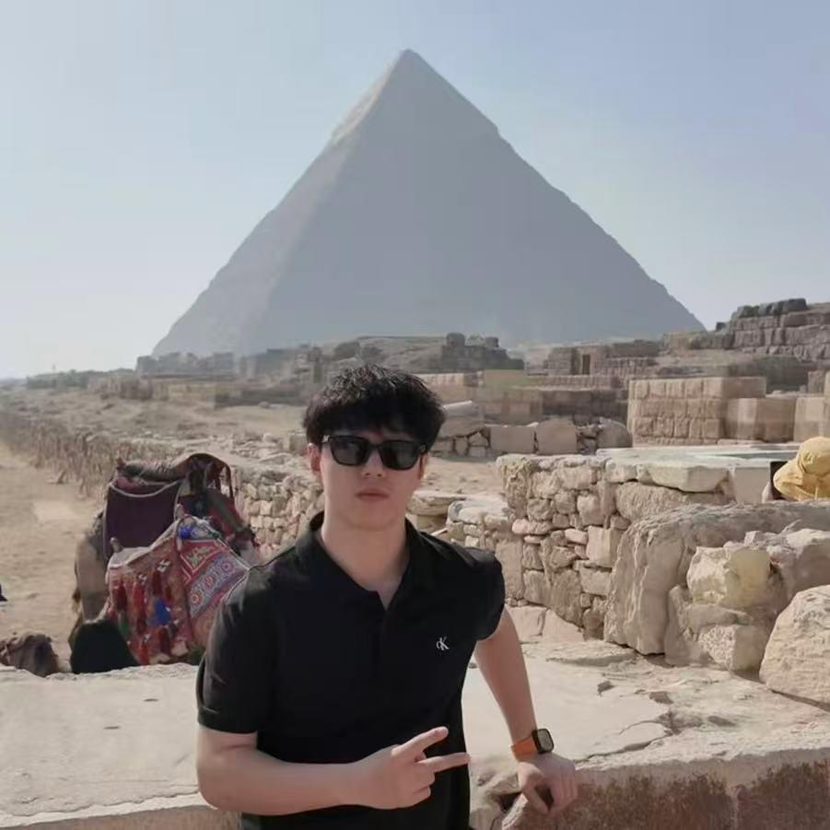

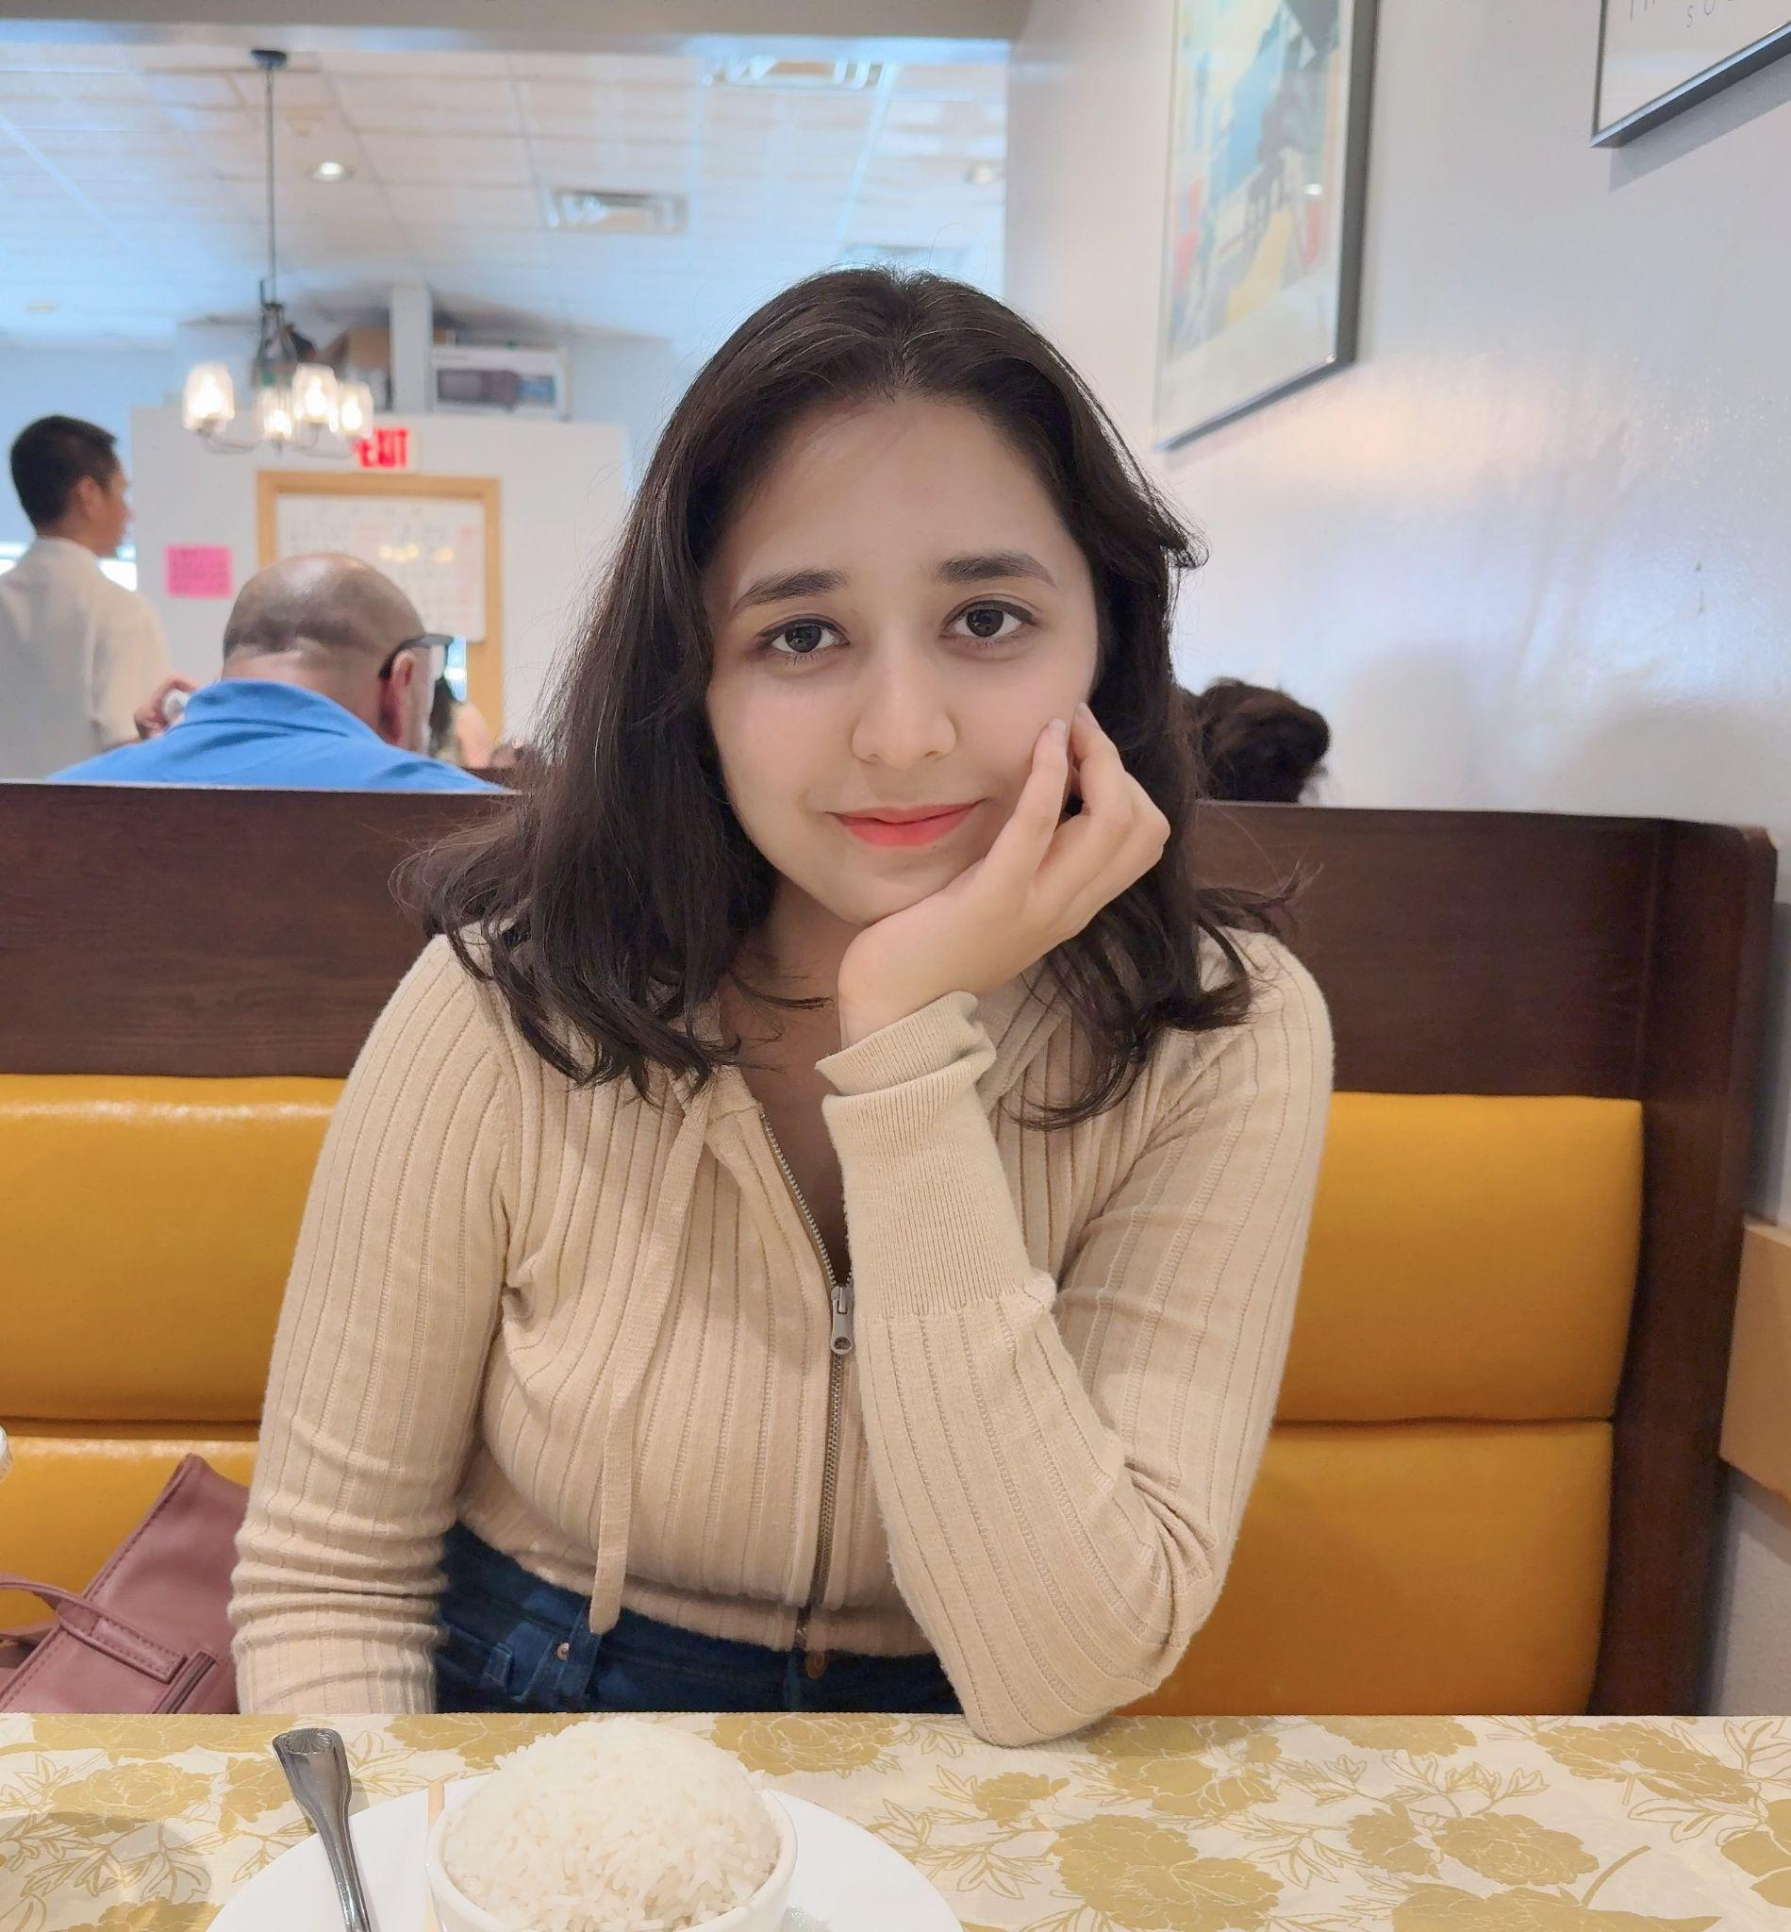
OUR TEAM
Javier Esteban de Celis
Saniya Bhambhvani
Configuration Leader
Team Leader
Vamsi Garghi
Yuanfei He
Requirement Leader
QA Leader
Johannes Bekele
Shreya Rana
Design and Implementation Leader
Security Leader

Slide 5

OUR PROJECT
OUR PROJECT
OUR PROJECT
OUR PROJECT
OUR PROJECT

Slide 6

EVENT MANAGER

Slide 7




PROJECT SCOPE
Motivation and Purpose
Users find other applications overwhelming and complex to use. Our team wants to develop a lightweight, privacy-conscious application to allow users to easily create and manage events. Our Event Manager will work to enhance user functionality, focus on design quality, and provide detailed post-event analytics.

Slide 8
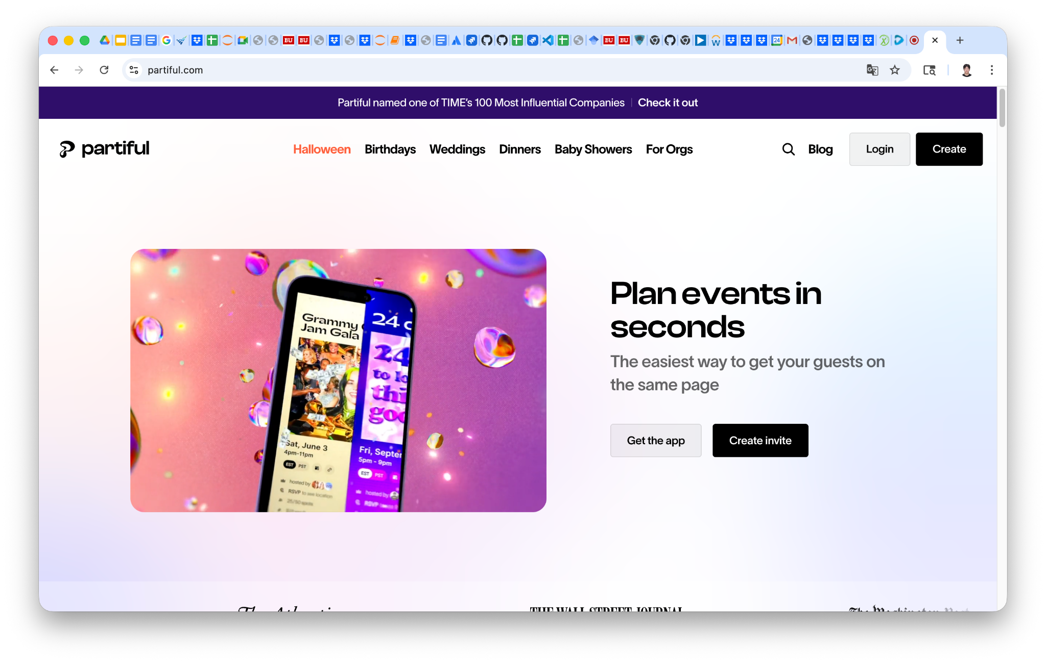
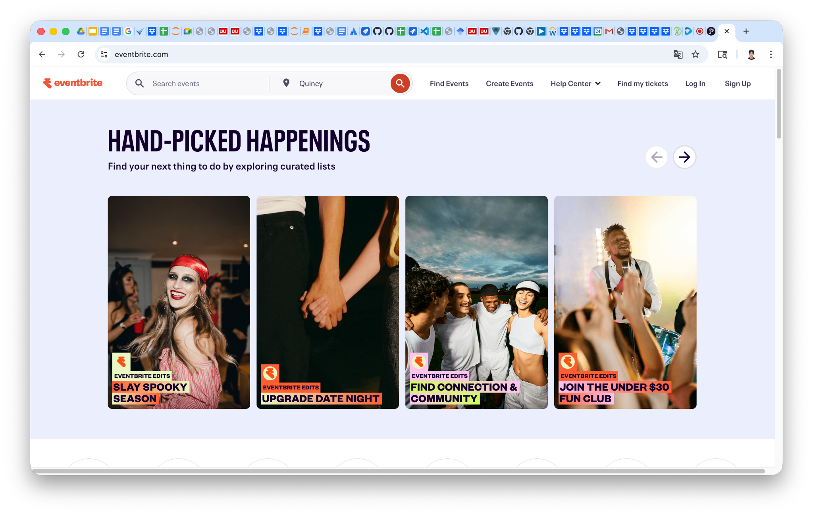
COMPETITORS
Partiful
Eventbrite

Slide 9

FUNCTIONAL REQUIREMENTS
FUNCTIONAL REQUIREMENTS
FUNCTIONAL REQUIREMENTS
FUNCTIONAL REQUIREMENTS
FUNCTIONAL REQUIREMENTS
FUNCTIONAL REQUIREMENTS
FUNCTIONAL REQUIREMENTS
FUNCTIONAL REQUIREMENTS
FUNCTIONAL REQUIREMENTS

Slide 10



FUNCTIONAL REQUIREMENTS
Core Features:
Unified Role Model
Event Creation and Management
Ticketing and Registration
Digital Ticket Delivery
Interactive Maps for Discovery
Additional Features:
Online Ticket Payment Processing
Multi-Ticket Bundles
Advanced Analytics
Sales Summary
Attendees Analytics (Age, Gender, Location)

Slide 11
TECH STACK
Next.js
OAuth2
Frontend Development
User LogIn
REST APIs (Python + FastAPI)
Git/GitHub
Backend Development
Version Control
SQLite and PostgreSQL
Docker
Information Storage
Configuration Deployment

